Slide 1


New Trends – Consider Google and Valve
Welcome to the Land of Do-As-You-Please
Notes:
Image from http://en.wikipedia.org/wiki/The_Magic_Faraway_Tree_(novel)

Slide 2

Everyone tries to predict trends driving software development
IoT (Internet of Things) – thing-smart integration will lead to collection hubs and centralized “Brains”
Business people may become software developers. (Driven by analytics?)
More intelligent apps (think Watson) and software-defined apps (“Open world”)
Virtualized everything (all in the cloud)?
“Software development” becomes
.
blurred
Notes:
Image from http://www.genco.com/insights/how-the-internet-of-things-will-help-measure-carbon-emissions/

Slide 3
Roger Pressman’s 2009 Predictions
“Soft trends”:
Connectivity and collaboration
Globalization
An aging population = people leaving the field
Consumer spending in emerging economies
  They’ll buy things with a software component
Software teams will grow in size, projects in complexity
  Team interfaces become pivotal to success
As systems become more open – What’s a team?
Notes:
From http://www.jasst.jp/archives/jasst09e/pdf/A1.pdf

Slide 4
Warning
Trying to characterize a process at a particular company is extremely dicey.
Companies have hundreds and thousands of employees.
Management can do some things to set the culture. But usually the primary determinant of the culture is people you interact with every day.
Also people like different things.
Also, different companies are shaped by very different forces.
E.g., Yesterday – “Every group you join will be different, and will change with each new project.”

Slide 5
All Software Processes, Everywhere, Try to Do This:
Hire some smart talented people
Motivate them
Have them figure out some great idea
Then build in a coordinated way
Profit

Slide 6
Is Agile a Fad?
The “Agile is dumb” resources you read:
“Agile ruined my life” is an ongoing opinion board with 120 responses.
  What is a valid criticism you read there?
  What are things that might be true, to watch out for?
  Is it “just best practices”?
  In your groups, describe your favorite part of this. Then, each group, tell one of these to everybody.

Slide 7

Brief Example –
Software Process at Google
Freedom to work on different projects
Not a lot of managers and managers also code
“Proving yourself” to other software developers extremely important
Profound tons of resources focused on you
Intense code reviews – strict guidelines
Notes:
Google logo from http://velocityagency.com/a-google-centric-world/

Slide 8
What’s Google Want in New Hires?
On NPR Feb 27, 2014, Harvard Business School’s Nancy Koehn was asked what Google sought in their new hires. She said:
  Leaders,
  People who can step back and let others lead,
  Humility, and
  They know how to fail.

Slide 9
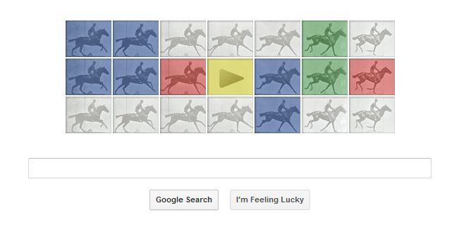
From the horse’s mouth:
April 19, 2014 New York Times interview with Lazlo Bock, who’s in charge of Google hiring:
  Grit – like taking hard college programs.
  Ability to learn things and solve problems.
  Both creative and logical.
  Combine things from two
  fields.
  Know how and why you
  achieved things.
  Can demonstrate how to achieve value.
  (And … 22% have no college degree!)
Notes:
Interview from http://www.nytimes.com/2014/04/20/opinion/sunday/friedman-how-to-get-a-job-at-google-part-2.html?_r=0
Image from http://www.pricenfees.com/google-doodle-wishes-eadweard-j-muybridge-through-horses.html

Slide 10
How do managers fare at Google?
From the HBR article you read, Google’s own studies showed that a good manager –
Is a good coach
Empowers the team and does not micromanage
Expresses interest in and concern for team members’ success and personal well-being
Is productive and results-oriented
Is a good communicator—listens and shares information
Helps with career development
Has a clear vision and strategy for the team
Has key technical skills that help him or her advise the team

Slide 11
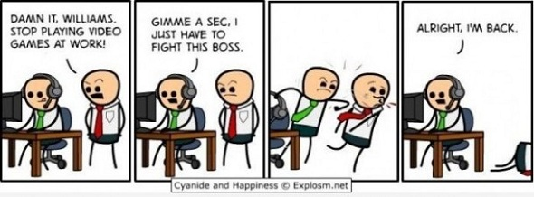
How About Video Game Companies?
From A Survey on a State of the Practice in Video Game Development – 2010 survey of Australian video game developers
  Scrum is most popular
  “Traditional Methods” not used at any studio, all are agile
  75% used version control
  35% used automated testing
Notes:
Image from http://www.joeaaronsellers.com/games/

Slide 12

What are the characteristics of
Valve and Its Processes?
In terms of “theories of the firm”:
  Existence – to build games – fun
    Thus it should be purposeful and fun
  Boundaries - open
  Organization - flat
  Heterogeneity of actions / performances they do
    Hiring and compensating the right people
  Evidence – tests for these actions
    Group decisions
Notes:
See http://en.wikipedia.org/wiki/Theory_of_the_firm
Image from http://assistantvillageidiot.blogspot.com/2012_04_01_archive.html

Slide 13
Unique to Valve - 1
“Cabals”
  See Ken Birdwell’s story of designing Half-Life: http://www.gamasutra.com/view/feature/3408/the_cabal_valves_design_process_.php
  Cross-section of the company
  Brainstormed and made decisions
  Needed enough people, including temporary non-contributors
  Tried to suppress egos
  Created a written group design
    Explained what things were for
  Did user play-testing as soon as possible
    Two hours = 100 fixes to do
  Got everyone involved
    Still relied on individual initiative
  Need people who are good subordinates, too

Slide 14
Valve’s Cabal “Tip Sheet”
Include an expert from every functional area (programming, art, and so on).
Write down everything.
Not all ideas are good.
Only plan for technical things that either already work, or that you’re sure will work within a reasonable time before play testing.
Avoid all one-shot technical elements.

Slide 15
Unique to Valve - 2
“Stack Ranking”
  Peer review process
  Compare with peers
  Determines compensation
  Expected behavior:
    Come up with a bright idea
    Tell a coworker about it
    Work on it together
    Ship it!

Slide 16
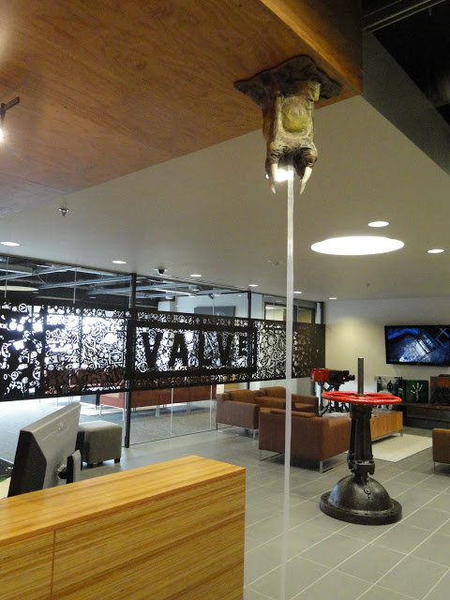
Valve - How people are rated
Skill level / technical ability
Productivity / output
Group contribution
Product contribution
Right – The Valve lobby, with valve
Notes:
Image from http://www.monstermache.net/2011/02/valve-software.html

Slide 17
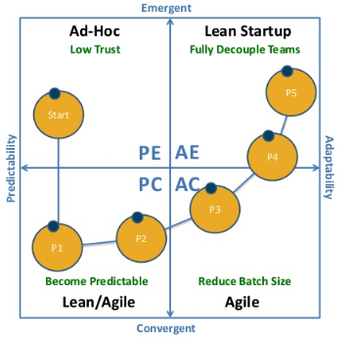
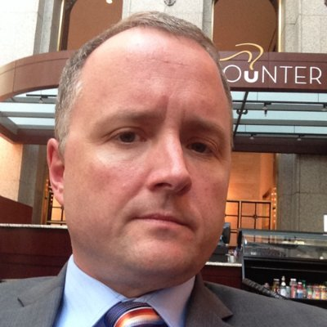
Is the end goal “startup,” not “agile”?
Mike Cottmeyer thinks the path from “Old school” through “Agile” looks like this:
Notes:
Link to some of Mike Cotmeyer’s main ideas, from http://www.stickyminds.com/interview/why-agile-fails-large-enterprises-and-what-do-about-it-interview-mike-cottmeyer.
Image of the way organizations progress, from http://www.leadingagile.com/2014/07/agile-failing-large-enterprises-can/.
Image of Mike from javascript:void(0)

